Slide 1
Metabolic Pathways

Slide 2
Metabolic pathway
A metabolic pathway is a series of enzyme-controlled chemical reactions that convert compounds from a precursor substance to an end product.

Slide 3
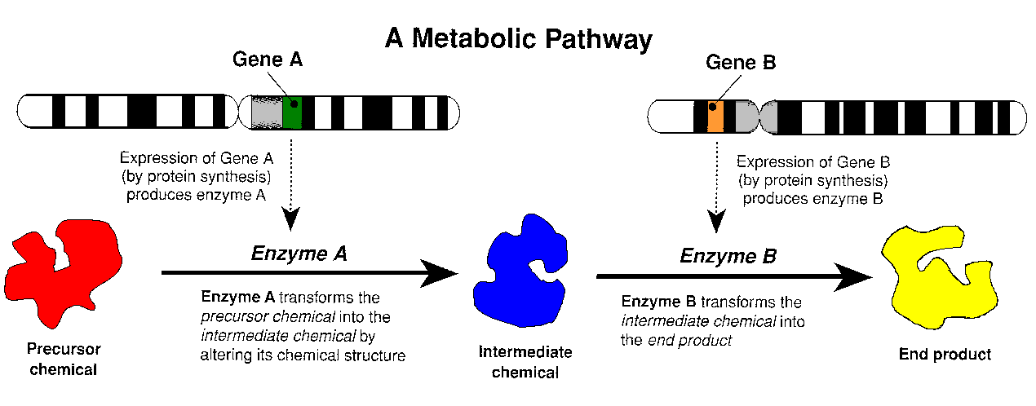

Slide 4
Mutations
A mutant gene may not produce the right enzyme, thus stopping the metabolic pathway. This results in;
Either: Build-up of a chemical.
Or: loss of products further along.
Either of these may cause harm.

Slide 5
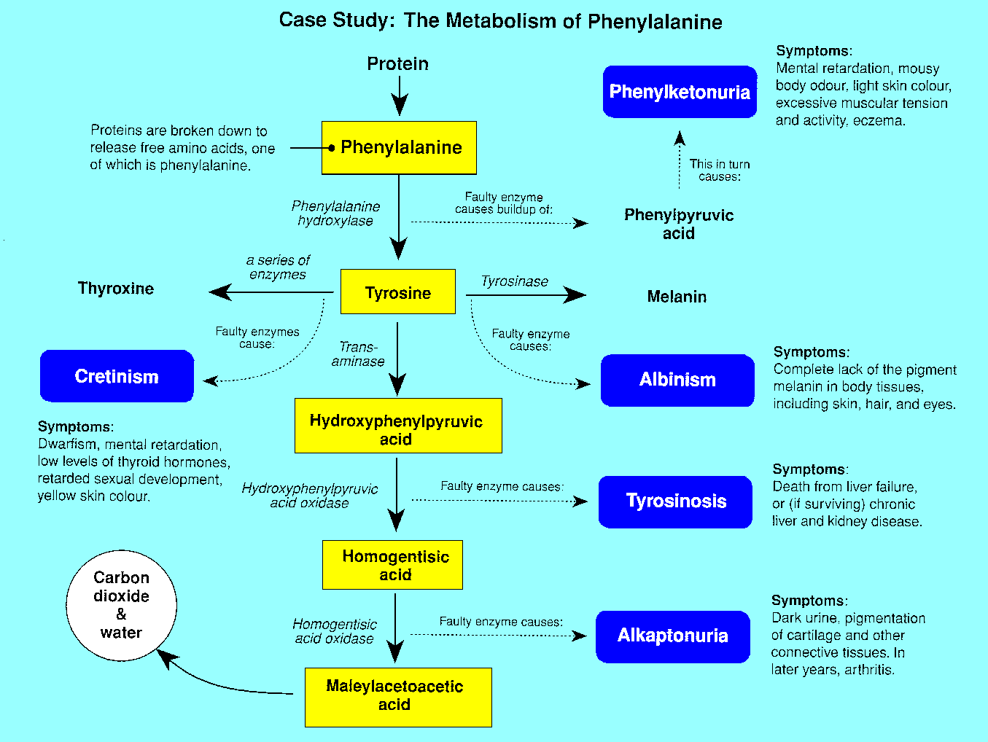
This diagram shows the enzyme pathways that result in the breakdown of phenylalanine for use as hormones, pigment or to produce energy and waste products

Slide 6
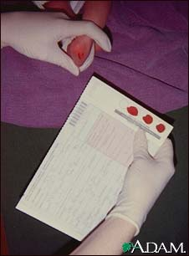
Testing for PKU
Blood is routinely drawn from newborn infants for testing. Blood is obtained by "heel stick" and collected on a special blotter paper. Routine testing usually includes phenylketonuria, thyroid function, and may test for other disorders.

Slide 7
The following are treatments often advised for children with PKU:
1. Medical formula
Even though they need less Phe, children with PKU still need a certain amount of protein. The medical formula gives babies and children with PKU the nutrients and protein they need while helping keep their Phe levels within a safe range.
Your metabolic doctor and dietician will tell you what type of formula is best and how much to use. Some states offer help with payment, or require private insurance coverage for the formula and other special medical foods.
2. Low-Phe food plan
The low-Phe diet is made up of foods that are very low in Phe. This means your child must not have cow's milk, regular formula, meat, fish, eggs or cheese. Regular flour, dried beans, nuts, and peanut butter also have Phe and must be avoided or strictly limited.

Slide 8
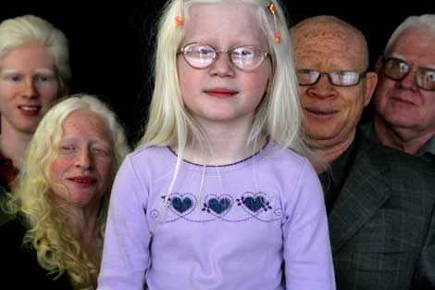
Albinism

